Slide 1
MAT 350
Engineering mathematics
Power Series Solutions of ODEs
Lecture: 12
Dr. M. Sahadet Hossain (Mth)
Professor
Department of Mathematics and Physics, NSU.

Slide 2





Slide 3
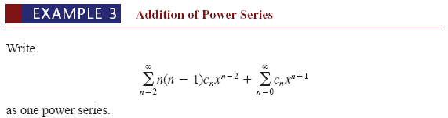

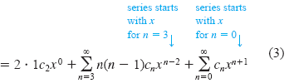
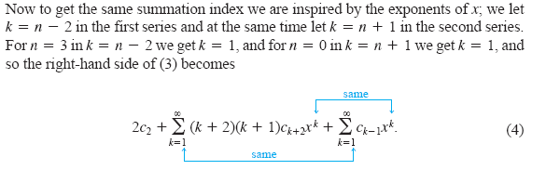

Slide 4
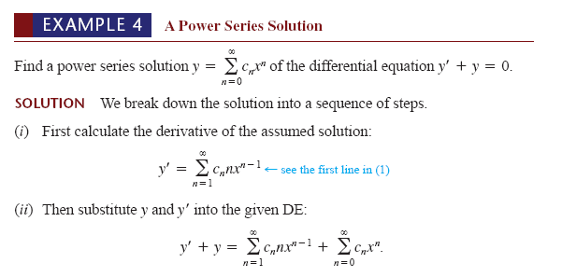

Slide 5
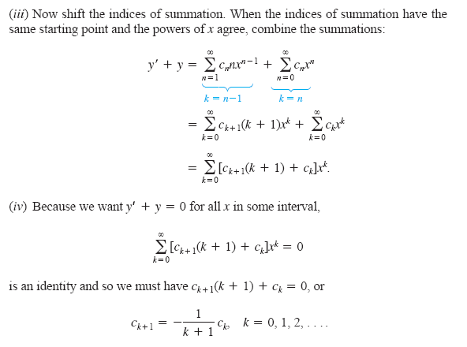

Slide 6
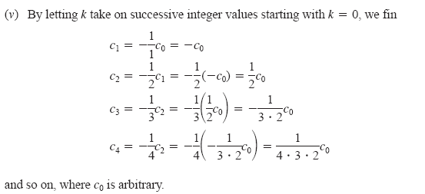

Slide 7
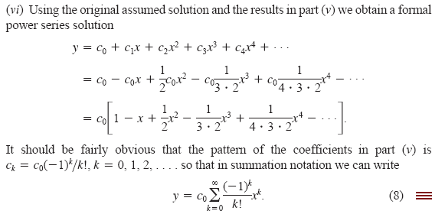

Slide 8
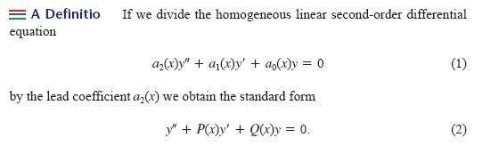
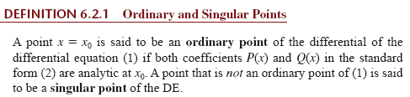

Slide 9


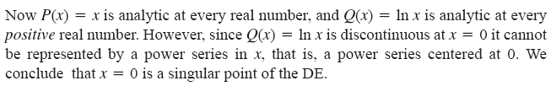

Example-1
Example-2

Slide 10
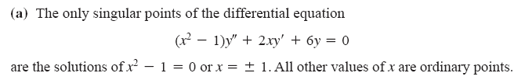
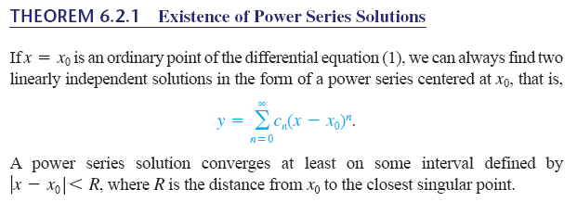

Example-3

Slide 11





(4)

Slide 12


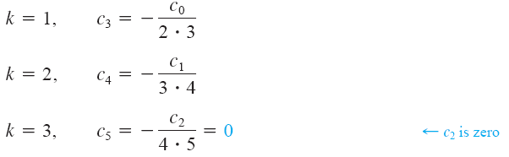
Equating
(5)

Slide 13
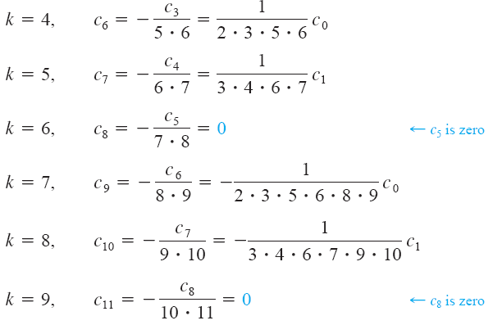

Slide 14

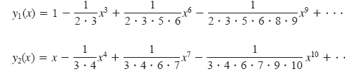

Slide 15




Slide 16
Text Books. A First Course in Differential Equations with Modelingand Applications, (10th Edition, Author-Dennis G. Zill.)
Exercises
Exercise: 6.1 Page-237
#23,25,26,31,34
Exercise: 6.2 Page-
#8,9,15,17,
Exercise: 6.3 Page-
1,3,4

